Slide 1
Agents in Action: Collaborative Discovery of Long COVID Mechanisms and Interventions
Jon Douglas
https://github.com/jondouglas/longcovid
Video Walkthrough

Slide 2
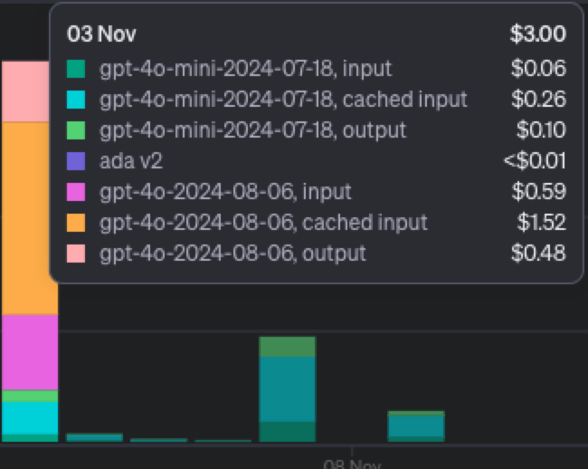
Introduction
Long COVID is a major public health challenge of our time, affecting over 7% of the global population, including adults and children, even after mild cases of SARS-CoV-2 infection.
Multi-agent systems are empowering research teams across the globe to achieve more with less.
I want to explore its potential to open new pathways in research for complex illnesses like Long COVID.
This technology is affordable at < $3 USD (gpt-4o) and < $1 USD (gpt-4o-mini) per run.
Can likely be optimized to consume less tokens with deep profiling.

Slide 3
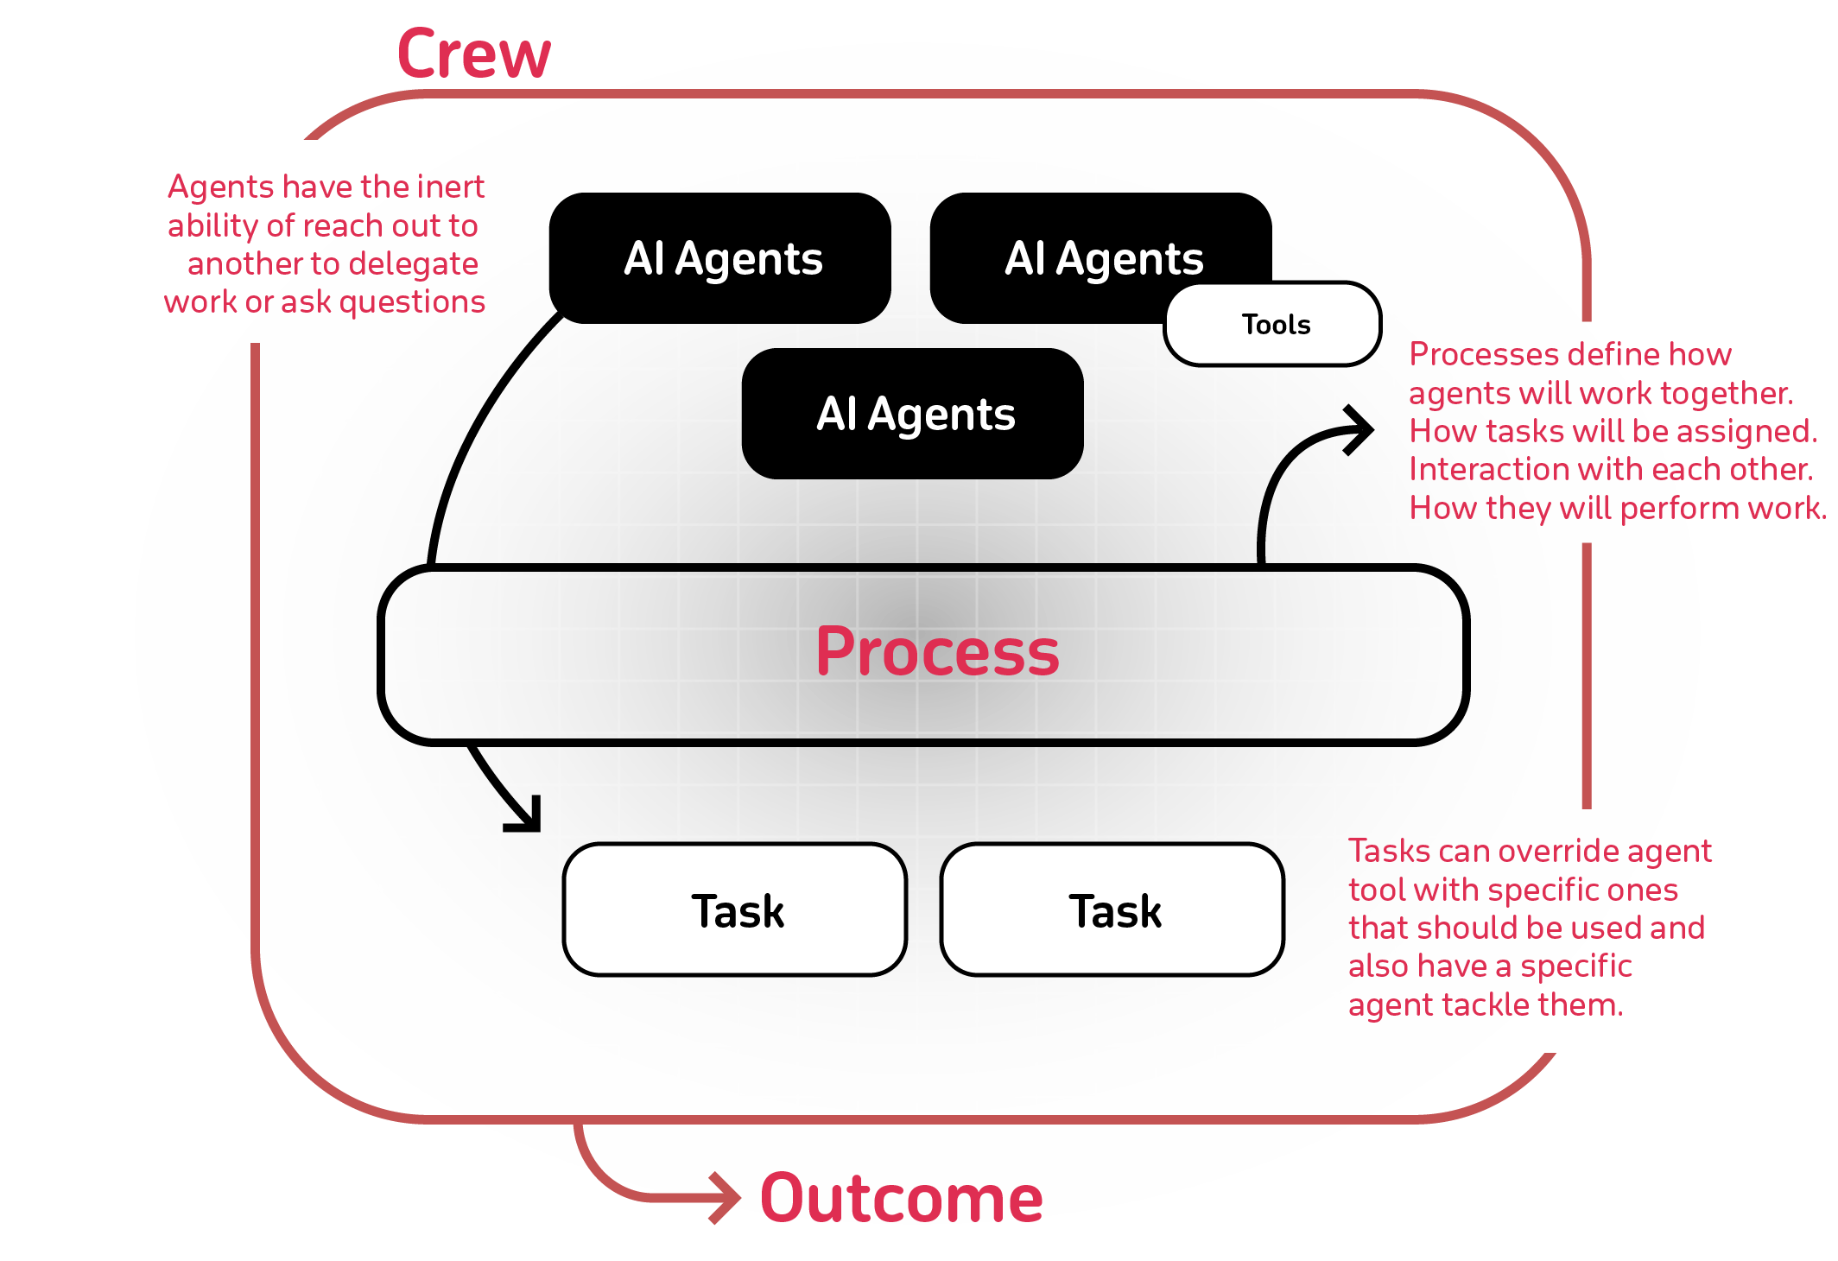
Overview of CrewAI

Slide 4
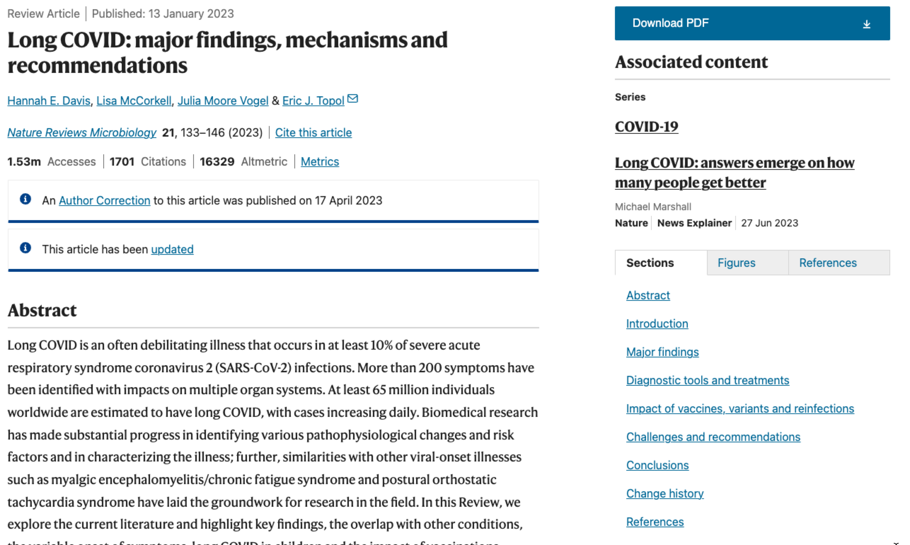
Long COVID

Slide 5
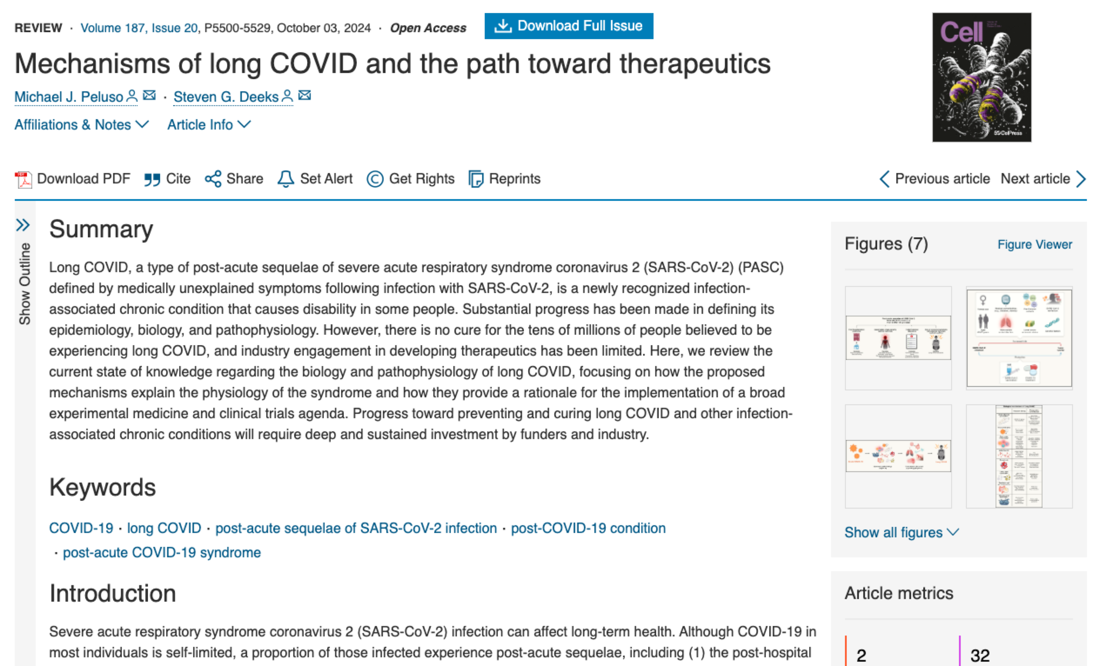
Mechanisms of Long COVID

Slide 6
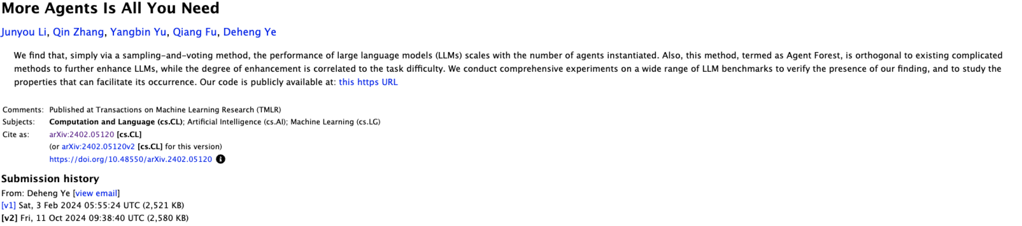
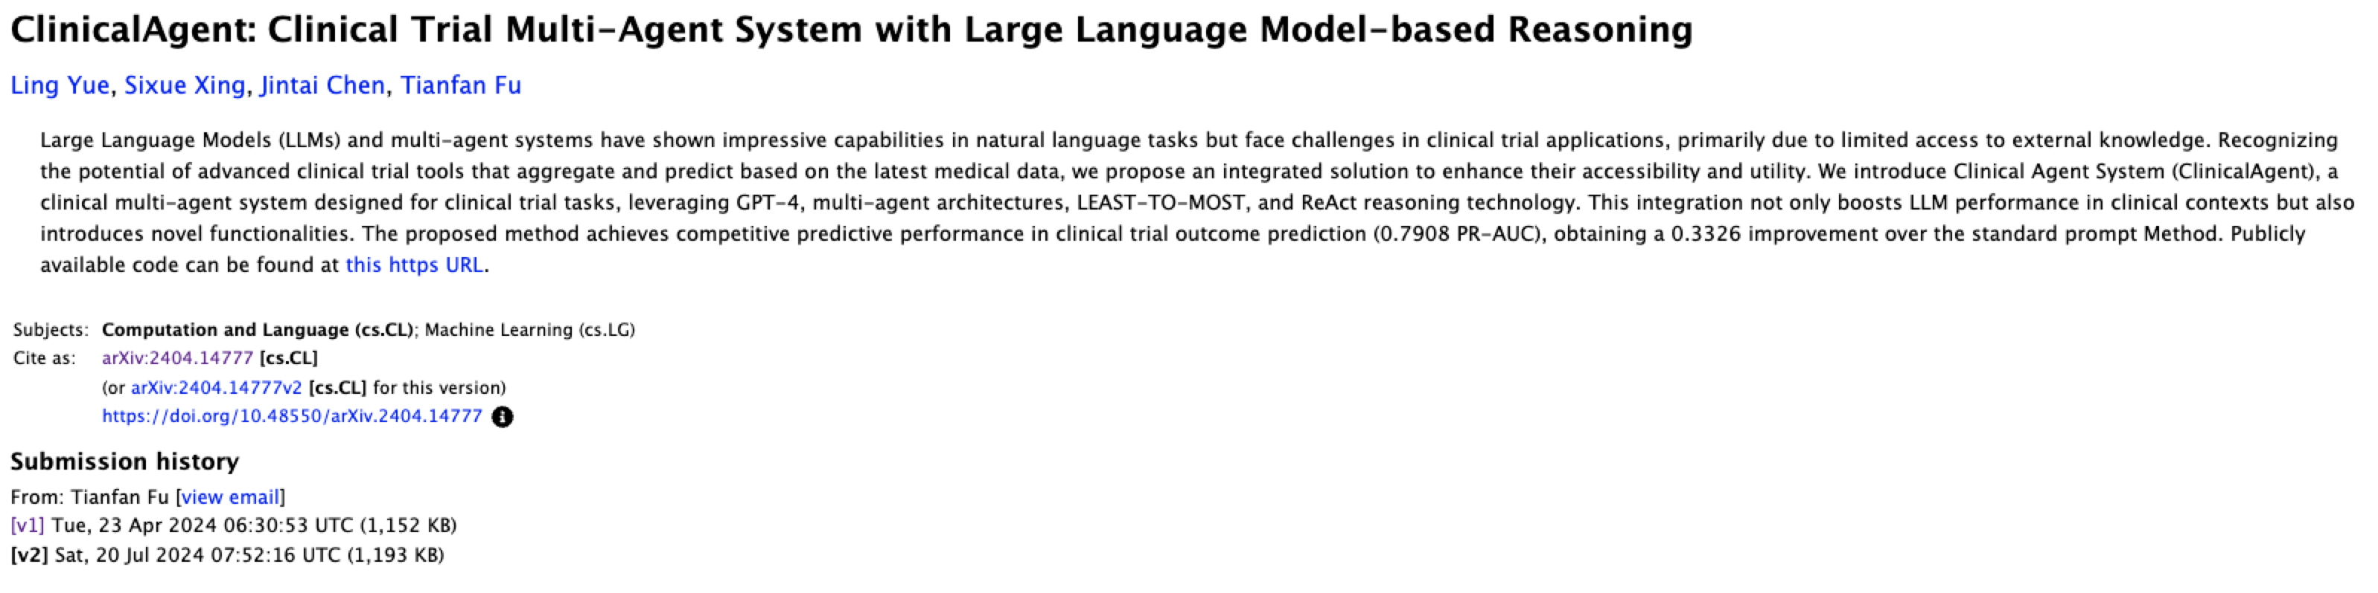
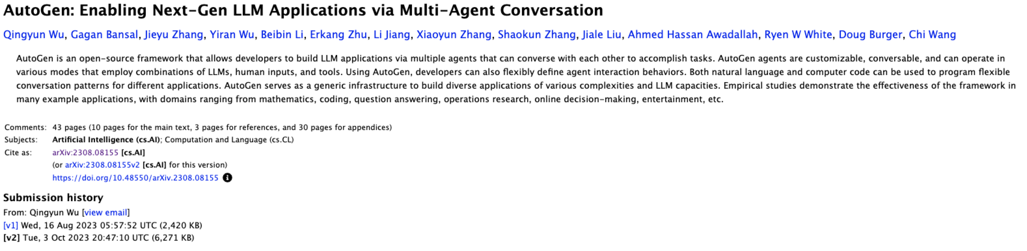

Slide 7
Methodology
14 specialized AI agents collaborate investigate the top 15 leading hypotheses, identify up to 20 potential therapeutics, and propose 10 combination treatments based on known mechanisms of Long COVID.
AI agents are inspired by real-life heroes in the fight against Long COVID.
The Lead Medical Researcher synthesizes insights from other experts to formulate cohesive research hypotheses.
The Pharmacology Expert and Treatment Strategy Analyst collaborate to design combination therapies.
The Data Analyst supports these efforts by validating hypotheses through data interpretation.
21 distinct reports are generated within ~15 minutes on analysis, mechanisms, treatments, management, and unified final reports.

Slide 8
Demo

Slide 9
Sample Results
Immunology Agent
Identified dysregulated T and B cells in Long COVID patients.
Elevated pro-inflammatory cytokines (IL-6, TNF-α).
Biomarkers for disease severity: exhausted T cells (PD-1, Tim-3).
Virology Agent
Detected viral reservoirs in gastrointestinal and neuronal tissues.
Correlated SARS-CoV-2 components (spike protein) with ongoing immune responses and neurological symptoms.
Pharmacology Agent
Evaluated therapies targeting viral persistence and immune dysregulation.
Proposed combination treatments (antivirals + immune-modulators, e.g., monoclonal antibodies with IL-6 inhibitors).

Slide 10
Future Direction
Prompting can utilize advanced prompt engineering techniques(few-shot, chain of thought, instruction priming, dynamic prompting, etc) furthering the continued validation of certain hypotheses/mechanisms (i.e. Viral persistence/immune dysregulation).
Additional agents can be utilized based on further advanced techniques being used by public institutions / NIH (i.e. Big data / ultra sensitive assays / transcriptomics)
Agents can be organized in scientific “Crews” which can provide better organization and “Flows” to the program rather than the current architecture.
Proprietary data sources could be used (i.e. antiviral tissue penetration, combination pharmacokinetics, etc)
Deep linked research references to credible sources used.

Slide 11
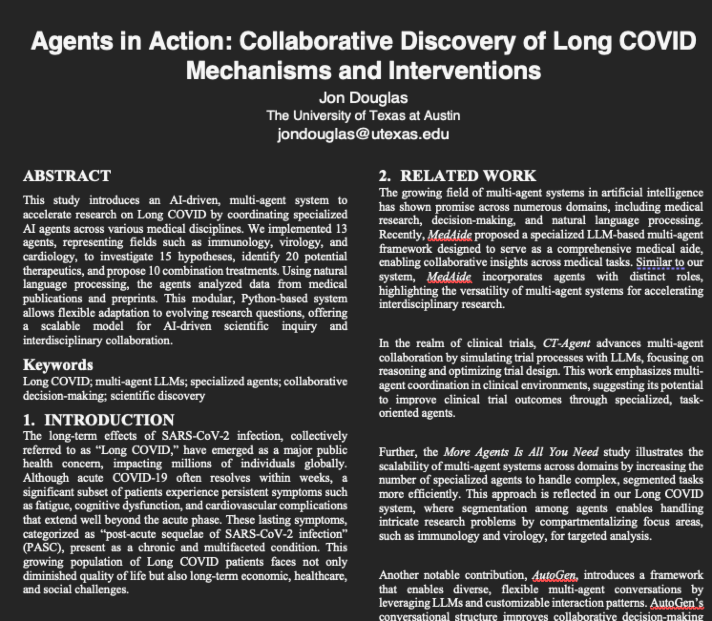
Associated paper: Agents in Action

Slide 12
Resources
https://github.com/jondouglas/longcovid
https://docs.crewai.com/introduction
https://platform.openai.com/
https://serper.dev/ (optional)
https://pubmed.ncbi.nlm.nih.gov/
https://biorxiv.org/ / https://www.medrxiv.org/

Slide 13
References
Nalbandian, A., Sehgal, K., Gupta, A., Madhavan, M. V., McGroder, C., Stevens, J. S., Cook, J. R., Nordvig, A. S., Shalev, D., Sehrawat, T. S., et al. 2021. Post-acute COVID-19 syndrome. Nat. Med. 27, 601-615. DOI: https://doi.org/10.1038/s41591-021-01283-z.
Davis, H. E., McCorkell, L., Vogel, J. M., and Topol, E. J. 2023. Long COVID: major findings, mechanisms, and recommendations. Nat. Rev. Microbiol. 21, 133-146. DOI: https://doi.org/10.1038/s41579-022-00846-2.
Peluso, M. J., and Deeks, S. G. 2024. Mechanisms of long COVID and the path toward therapeutics. Cell 187, 20, 5500-5529. DOI: https://doi.org/10.1016/j.cell.2024.07.054.
Wei, J., Yang, D., Li, Y., Xu, Q., Chen, Z., Li, M., Jiang, Y., Hou, X., and Zhang, L. 2024. MedAide: Towards an Omni Medical Aide via Specialized LLM-based Multi-Agent Collaboration. arXiv preprint arXiv:2410.12532. Available at https://arxiv.org/abs/2410.12532.
Yue, L., Xing, S., Chen, J., and Fu, T. 2024. ClinicalAgent: Clinical Trial Multi-Agent System with Large Language Model-based Reasoning. arXiv preprint arXiv:2404.14777. Available at https://arxiv.org/abs/2404.14777.
Li, J., Zhang, Q., Yu, Y., Fu, Q., and Ye, D. 2024. More Agents Is All You Need. arXiv preprint arXiv:2402.05120. Available at https://arxiv.org/abs/2402.05120.
Wu, Q., Bansal, G., Zhang, J., Wu, Y., Li, B., Zhu, E., Jiang, L., Zhang, X., Zhang, S., Liu, J., Awadallah, A. H., White, R. W., Burger, D., and Wang, C. 2023. AutoGen: Enabling Next-Gen LLM Applications via Multi-Agent Conversation. arXiv preprint arXiv:2308.08155. Available at https://arxiv.org/abs/2308.08155.
Lu, C., Lu, C., Lange, R. T., Foerster, J., Clune, J., and Ha, D. 2024. The AI Scientist: Towards Fully Automated Open-Ended Scientific Discovery. arXiv preprint arXiv:2408.06292. Available at https://arxiv.org/abs/2408.06292.
Gao, S., Fang, A., Huang, Y., Giunchiglia, V., Noori, A., Schwarz, J. R., Ektefaie, Y., Kondic, J., and Zitnik, M. 2024. Empowering biomedical discovery with AI agents. Cell, 187, 6125-6141. DOI: https://doi.org/10.1016/j.cell.2024.09.022

